Slide 1
Python Introduction

Slide 2
ABOUT PYTHON
Python is dynamic, interpreted high level language.
Syntax are said to be clear and expressive.
Has a large and comprehensive standard library.
Source code does not declare the type of variables or parameters or methods.
Makes the code short and flexible.
Tracks the type of all variables at run time.
Does not declare the variables just assign them and go. Its Case sensitive

Slide 3
Does not require a semi colon at the end of each statement.
Raises run time error if the code tries to read from a variable that not been given a value.
Supports multiple programming paradigms including object oriented, imperative and functional programming style.
Fully dynamic type system and automatic memory management, similar to that of Scheme, Ruby, Perl, and Tcl Python often used as scripting language.
Like Java, once written programs can be run on any operating system. Its not possible to write a java program without writing at least one class! This makes program lengthy

Slide 4
For example, a simple program to add two numbers in java looks like this:
Class Add
{
public static void main(string args[])
{
int a,b;
a=b=10;
System.out.println(“sum=“+(a+b));
}
}

Slide 5
The same program to add two numbers can be written in C as:
#include<stdio.h>
Void main()
{
int a,b;
a=b=10;
printf(“Sum= %d”,(a+b));
}
There is no improvement in the length of code

Slide 6
Python combines the feature of C and Java
Offers elegant style of developing programs like C
When the programmer want to go for object orientation, it offers classes and objects like java.
In python, the program to add two numbers will be as follows:
a=b=10
print(“Sum= “,(a+b))

Slide 7
History
Python was developed by Guido Van Rossum in the year 1991 at the center of mathematics and Computer Science managed by Dutch Government
Van Rossum was working on a project to develop system utilities in C where he had to interact with the Bourne shell available in UNIX.
He felt the necessity of developing a language that would fill the gap between C and the shell
Van Rossum picked the name python for the new language from the TV show, Monty Python’s Flying Circus.
Python’s first working version was ready by early 1990 and Van Rossum released it for the public on February 20,1991.

Slide 8
Applications
AI and machine learning
Because Python is such a stable, flexible, and simple programming language, it’s perfect for various machine learning (ML) and artificial intelligence (AI) projects.
Data Analytics
The language is easy-to-learn, flexible, and well-supported, meaning it’s relatively quick and easy to use for analyzing data.
When working with large amounts of information, it’s useful for manipulating data and carrying out repetitive tasks.

Slide 9
Data visualisation
Python provides a variety of graphing libraries with all kinds of features.
Whether you’re looking to create a simple graphical representation or a more interactive plot, you can find a library to match your needs. Examples include Pandas Visualization and Plotly.
Programming Applications
The general-purpose language can be used to read and create file directories, create GUIs and APIs, and more.
Whether it’s blockchain applications, audio and video apps, or machine learning applications, you can build them all with Python.

Slide 10
Web Development
Python is a great choice for web development.
This is largely due to the fact that there are many Python web development frameworks to choose from, such as Django, Pyramid, and Flask.
These frameworks have been used to create sites and services such as Spotify, Reddit and Mozilla.
Game Development
It’s possible to create simple games using the programming language, which means it can be a useful tool for quickly developing a prototype.

Slide 11
Language development
The simple and elegant design of Python and its syntax means that it has inspired the creation of new programming languages.
Languages such as Cobra, CoffeeScript, and Go all use a similar syntax to Python.
Finance
Python is increasingly being utilised in the world of finance, often in areas such as quantitative and qualitative analysis.
It can be a valuable tool in determining asset price trends and predictions, as well as in automating workflows across different data sources.

Slide 12
SEO
Another slightly surprising entry on our list of Python uses is in the field of search engine optimisation (SEO).
It’s an area that often benefits from automation, which is certainly possible through Python.
Whether it’s implementing changes across multiple pages or categorising keywords, Python can help.
Design
Python can be used to develop graphic design applications.
Surprisingly, the language is used across a range of 2D imaging software, such as Paint Shop Pro and Gimp.

Slide 13
Drawbacks
Isn’t the best for memory intensive task.
Slow compared to C/C++ or Java.
Not a great choice for a high graphic 3D game that takes up a lot of CPU.

Slide 14
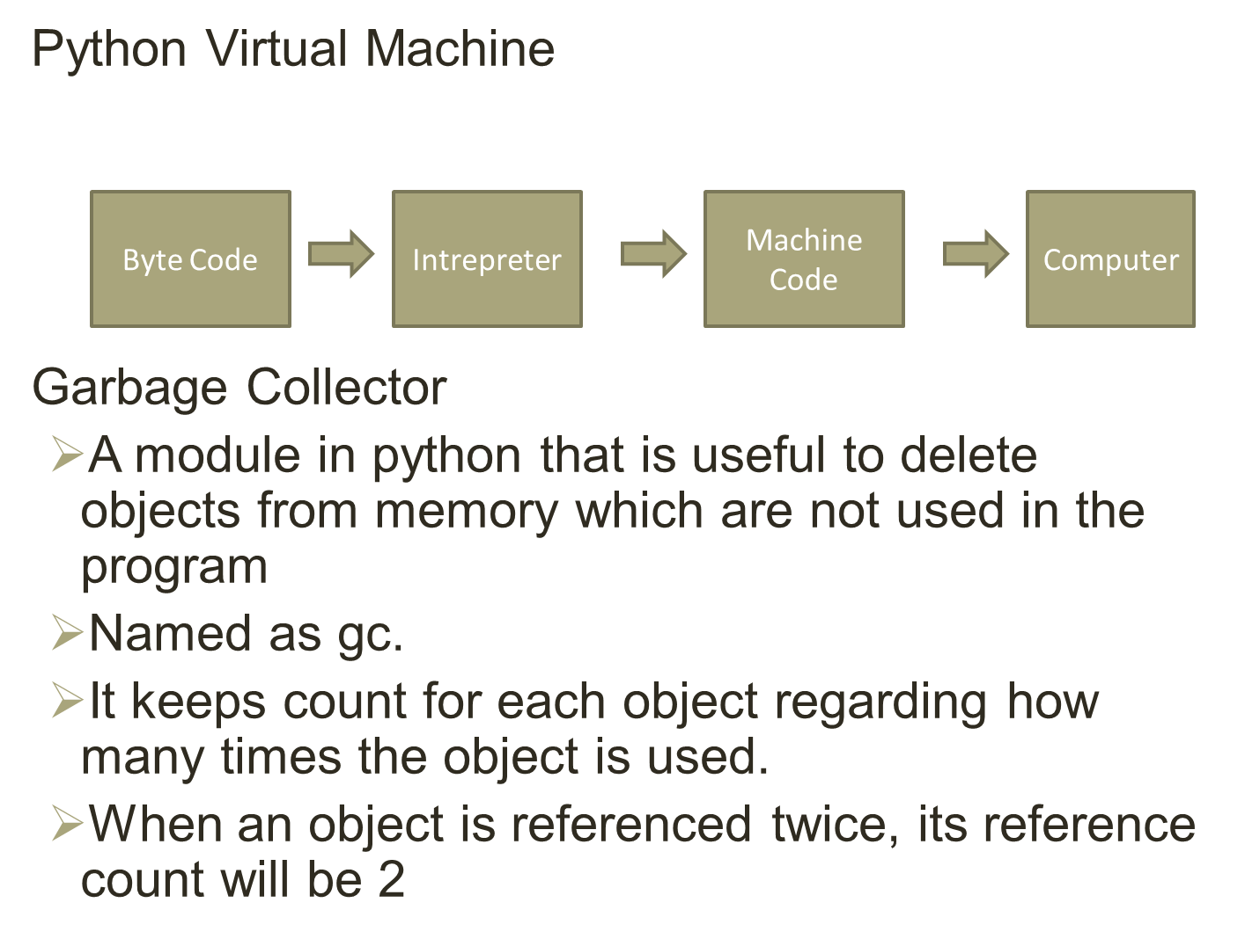

Slide 15
When an object has some count, it is being used in the program hence the garbage collector will not remove from memory.
When an object count is 0 gc will understand that the object is not used by the program and hence it is deleted from the memory.

Slide 16
TOPIC | Java | Python
Compilation process | Java is a compiled programming language | Python is an interpreted programming language
Code Length | Longer lines of code as compared to python. | 3-5 times shorter than equivalent Java programs.
Syntax Complexity | Define particular block by curly braces,end statements by ; | No need of semi colons and curly braces ,uses indentation
Ease of typing | Strongly typed, need to define the exact datatype of variables | Dynamic, no need to define the exact datatype of variables.
Speed of execution | Java is much faster than python in terms of speed. | Expected to run slower than Java programs
Multiple Inheritance | Multiple inheritance is partially done through interfaces | Provide both single and multiple inheritance

Slide 17
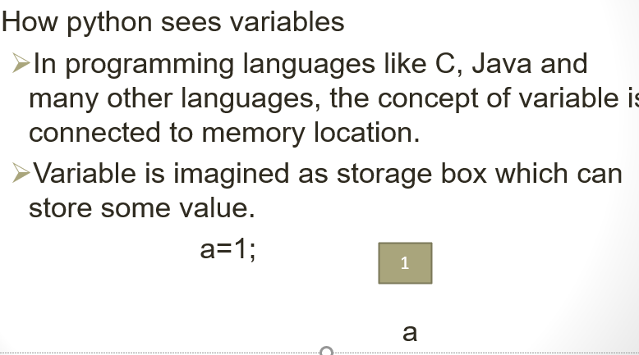

Slide 18
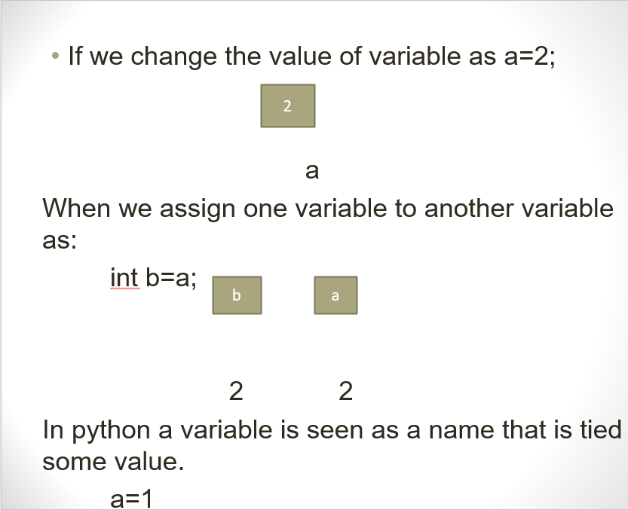

Slide 19
